Slide 1
Credit EDA Assignment
BY,
VISHNU KUMAR C

Slide 2
Contents
Problem Statement
Analysis – Application_data
Categorical Univariate Analysis for Target_0
Categorical Univariate Analysis for Target_1
Correlation with heatmap for both Target 0 and 1
Bi-variate Categorical plots
Analysis - Previous_application data
Univariate Analysis
Bi-variate Analysis
Conclusion

Slide 3
Problem Statement
When the company receives a loan application, the company has to decide for loan approval based on the applicant’s profile. Two types of risks are associated with the bank’s decision:
1. If the applicant is likely to repay the loan, then not approving the loan results in a loss of business to the company
2. If the applicant is not likely to repay the loan, i.e. he/she is likely to default, then approving the loan may lead to a financial loss for the company.
The company wants to understand the driving factors behind loan default i.e the variables which are strong indicator of default.
- The below case study has only the analysis part excluding the process of Data Cleaning (i.e data quality check and handling missing values)

Slide 4
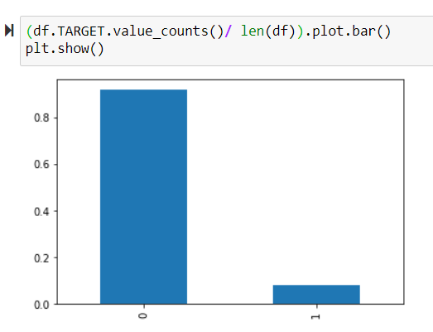
Analysis - Application_data
We have given two different datasets (i.e) application_data and previous_application data. Firstly, let’s take and analyse the application data as it has the defaulter details.
Checking Imbalance percentage :
As, it is must to check the data imbalance on a Target variable before proceeding with analysis.
From the above plot we can see that the data is imbalance as, Target value = 0 is higher (80+%) than Target value =1(<20%). So, the data can be divide into two as Target_0 and Target_1 for better analysis.

Slide 5
Categorical Univariate Analysis for Target_0

Slide 6
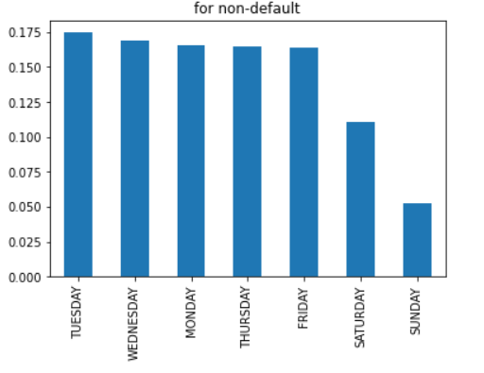
Distribution of Weekday_appr_process_star
Insights:
Most of the applications are processed in Tuesday.
As, we can see then the bank will be busy in Tuesdays
Next, Wednesday will be most of the applications are processed.
As, we all know weekends will be mostly holiday only less applications are processed in Saturday and Sunday.

Slide 7
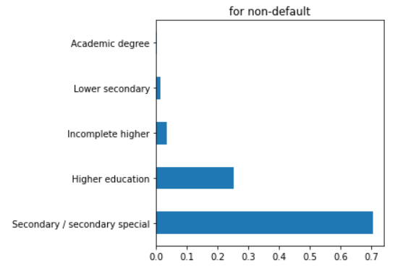
Distribution of Name_Education_Type
Insights:
As, we can see from the graph that most of the applicants nearly 70% who has secondary/secondary special education type are falls under non-defaulter.
Between 20-30% of the applicants of non-defaulters had done higher education.
There is very few/no records available for applicants with academic degree.

Slide 8
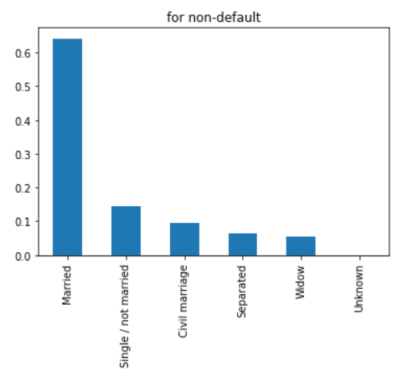
Distribution of Name_Family_Status
Insights:
We can incur from the bar plot that most of the married people are application for loan.
Also, more than 60% of them are able to repay the loan amount i.e they comes under non-defaulter.
Only few separated and widow people are applying for loan.

Slide 9
Categorical Univariate Analysis for Target_1

Slide 10
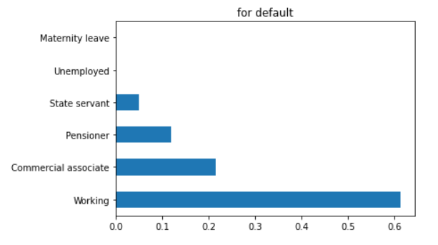
Distribution of Name_Income_Type
Insights:
From the above bar graph we can conclude nearly more than 60% of the working applicants are unable to repay the loan i.e they falls under defaulter.
There is no loss/profit for the bank from the people who are in maternity leave and unemployed as they have no records.

Slide 11
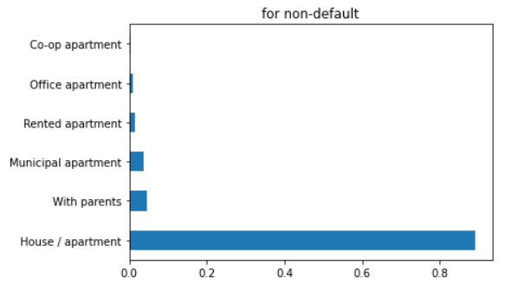
Distribution of Name_Housing_Type
Insights :
From the above graph, we can observe that more than 80% applicants whose living status is House/Apartment are in majority for defaulter.
Only few applicants who lives in office apartment or Rented apartment are defaulters.

Slide 12
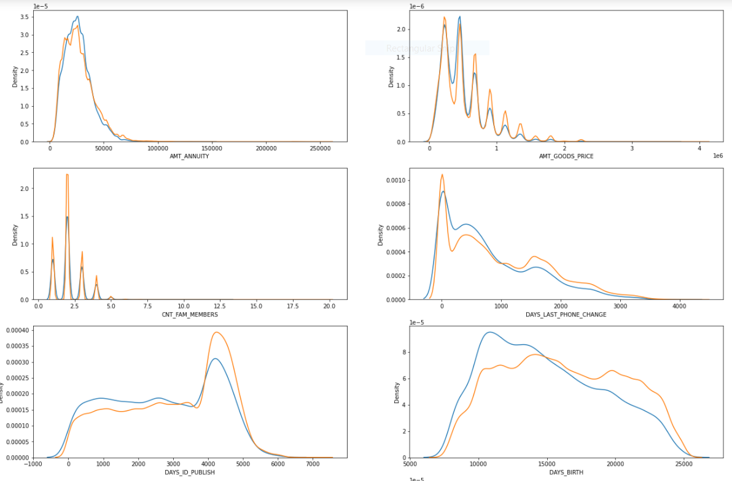
Considering 10 Continuous Variables

Slide 13
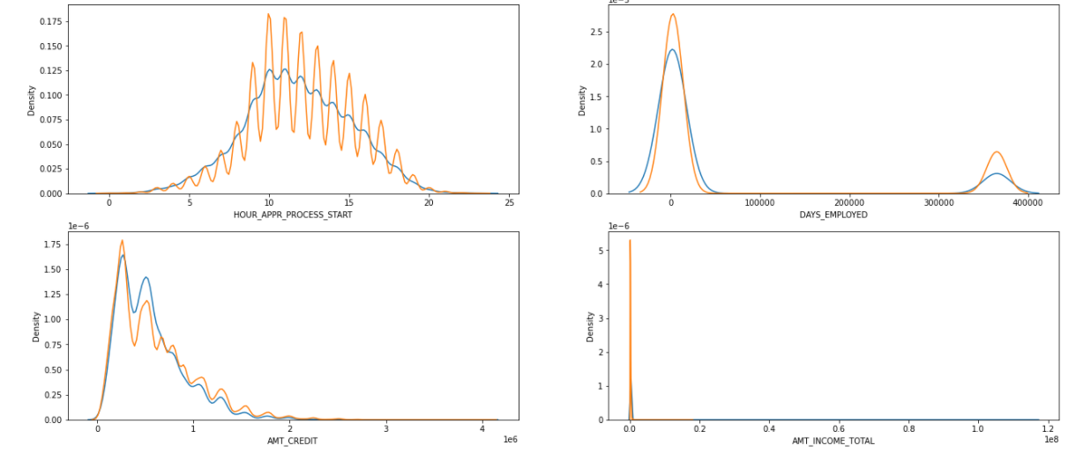

Slide 14
Insights from above distplots :
People with lower total income are more likely to default
People who just got employed tends to take more loans
People who retired tends to take more loans
High number of applications are filed in 10 AM to 2 PM
People with age between 27yrs(10000-days) and 41(15000-days) yrs tend to take more loans
People whose id(s) got published between 4000 days and 5000 days ago tend to take more loans
nuclear family tends to take more loans
For less goods amount people take loans
Low amount annuity has high number of loans

Slide 15
Correlation with heatmap for both Target 0 and 1

Slide 16
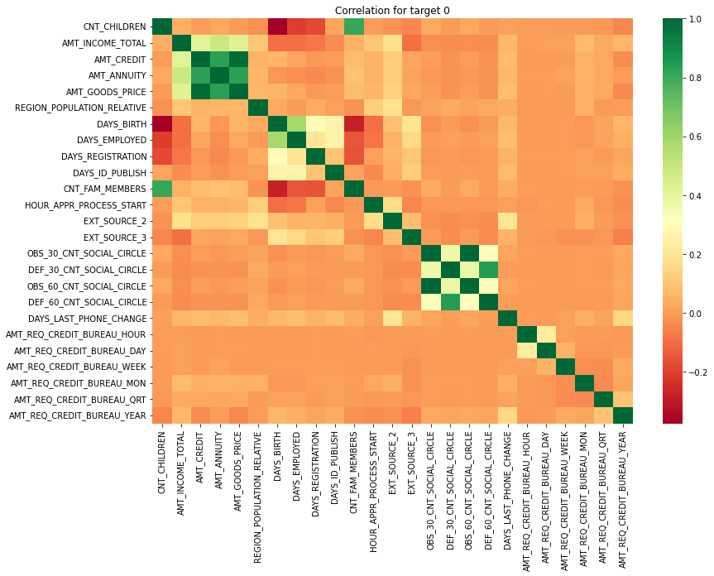

Slide 17
Insights :
Credit amount is inversely proportional to the date of birth, which means Credit amount is higher for low age and vice-versa.
Credit amount is inversely proportional to the number of children client have, means Credit amount is higher for less children count client have and vice-versa.
Income amount is inversely proportional to the number of children client have, means more income for less children client have and vice-versa.
Less children client have in densely populated area.
Credit amount is higher to densely populated area.
The income is also higher in densely populated area.

Slide 18
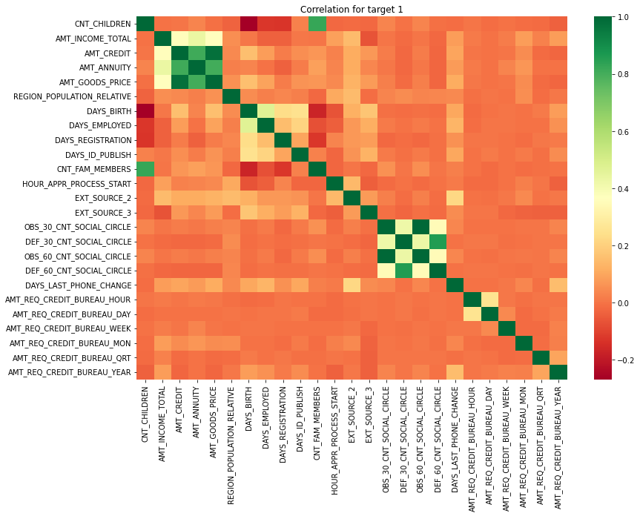

Slide 19
Bi-variate Categorical plots

Slide 20
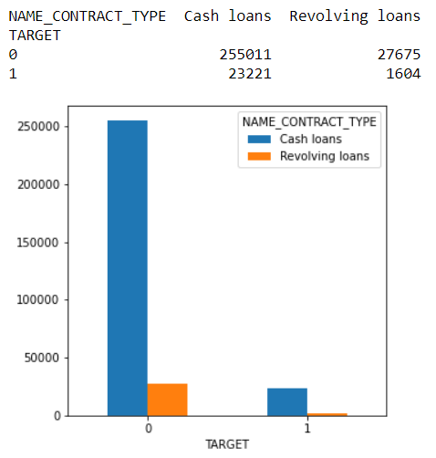
Target vs Name_Contract_Type
Insights:
The below bar plot shows that applicants who take cash loans are higher in both defaulter and non-defaulter.
Nearly, 25 lakhs applicants are applying for cash loans and also able to repay the loan amount.
Only, few are applying for revolving loans and also, those applicants are higher in non-defaulter bucket.

Slide 21
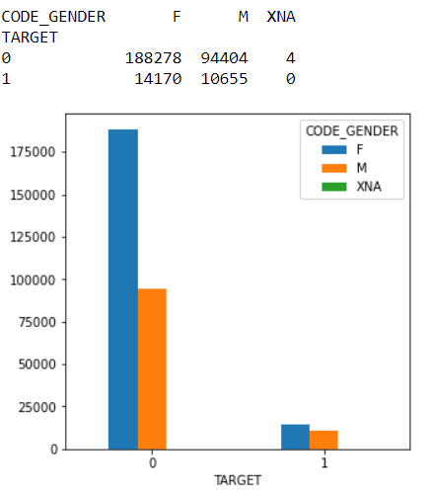
Target vs Code_Gender
Insights:
Points that can be clearly incurred from the plot i.e female applicants are more in number for applying loans than male.
Most of the female applicants who take loans are falls under non-defaulter.
There are only very few applicants are defaulters and there is no much difference in percentage between both male and female who are defaulter. (<25k)

Slide 22
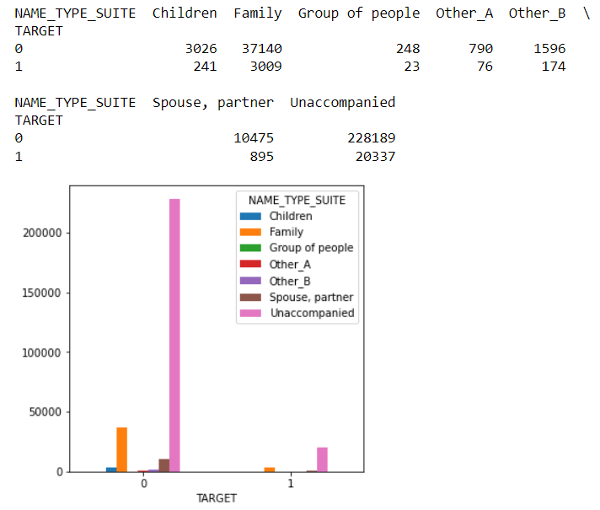
Target vs Name_Type_Suite

Slide 23
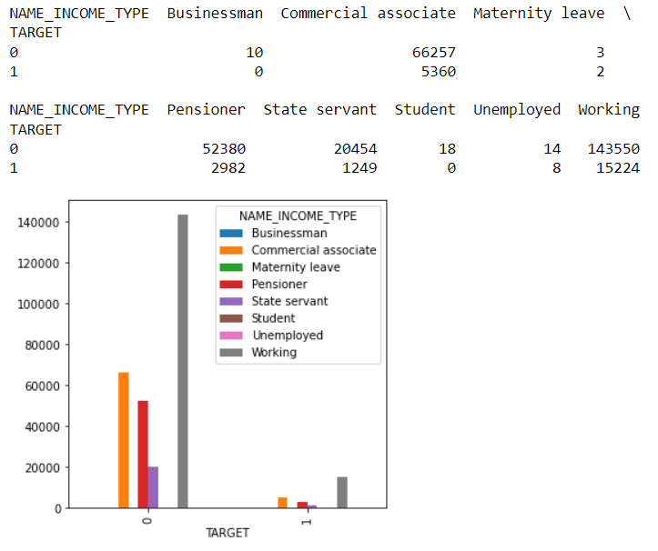
Target vs Name_Income_Type

Slide 24
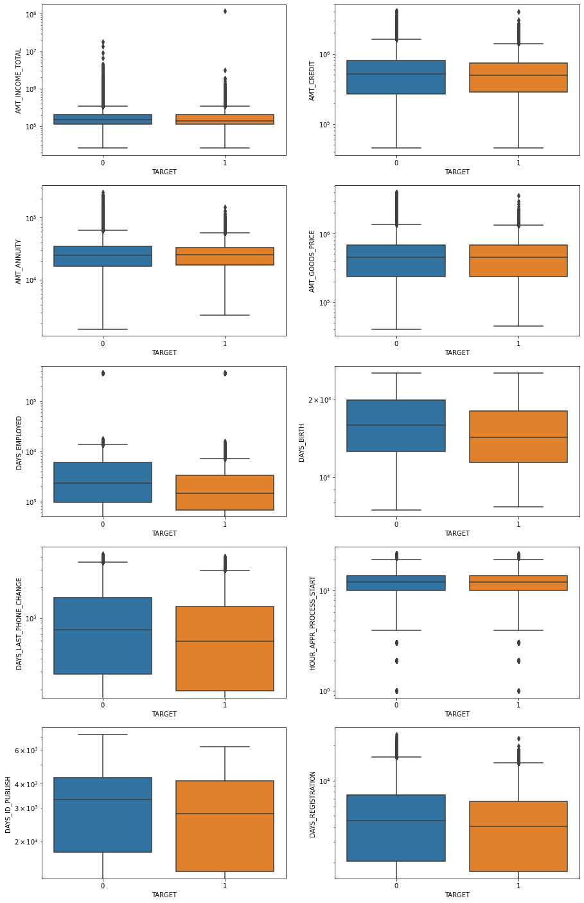
Bi-variate Continuous Plots

Slide 25
Insights:
For few not default clients, time taken to publish id's are higher than default clients.
The application process start hours taken for default and not default cases are similar.
In non default cases, people keep their phone numbers for greater time.
In non default case AMT_GOODS PRICE contains more outlers than default case.
In default case, most of the clients amount annuity tends to be greater than 25000(median value).
Whose credit amount is greater than 50000 tends to be less default than compared to default cases and vice versa.
people with higher no of employment days are less likely to default.
Majority of defaulting people are having less total income.

Slide 26
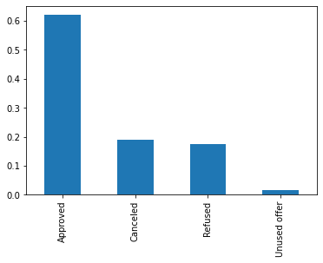
Analysis - Previous_application data
Now, we are going to see the insights of loan status of the applicants who applied loan previously using previous_application data. Name_Contract_Status is the target variable for this data as we need to check the loan status – Approved/Cancelled/refused/unused and the reason for that.
From the plot on the right hand side clearly
shows that,
- 60% of applications are approved
- 20% of the applications are cancelled/
refused.
- Only, few i.e less than 5% of the
applications are unused .

Slide 27
Univariate Analysis

Slide 28
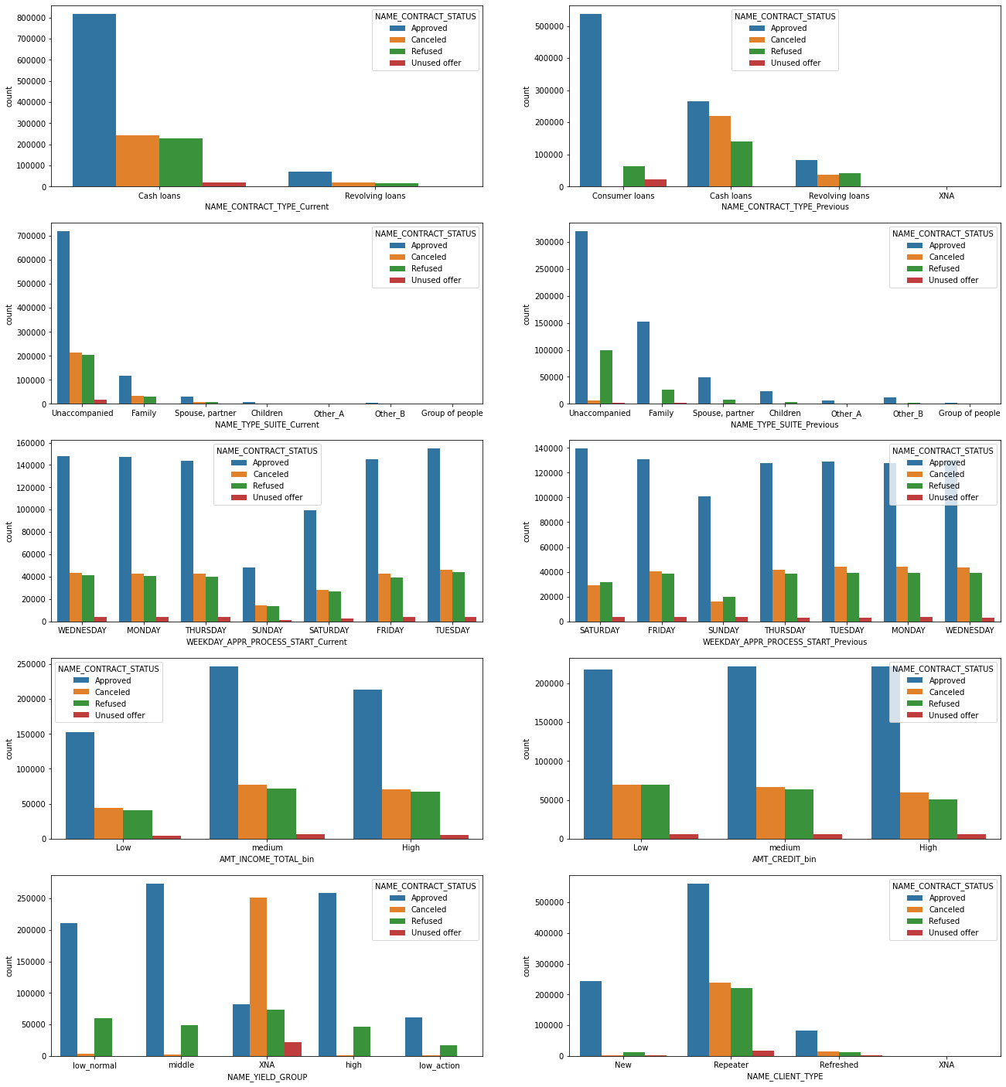
Univariate Categorical Analysis

Slide 29
Insights:
Repeater has highest number of approved loans.
Middle NAME_YIELD_GROUP has highest approval.
Value of AMT_CREDIT_BIN does not affect loan approvals.
For Medium AMT_INCOME_TOTAL_bin the approval is highest .
In previous application saturday has the highest approval rate but in current application it is tuesday.
For both NAME_CONTRACT_TYPE_Previous and NAME_CONTRACT_TYPE_Current unaccompanied has the highest number.
Previously bank was providing Cash, Revolving and Consumer loans.
Currently, bank is only giving two types of loans Cash and Revolving Loans.
Number of consumer loans were highest previously but now it is Cash loans.

Slide 30
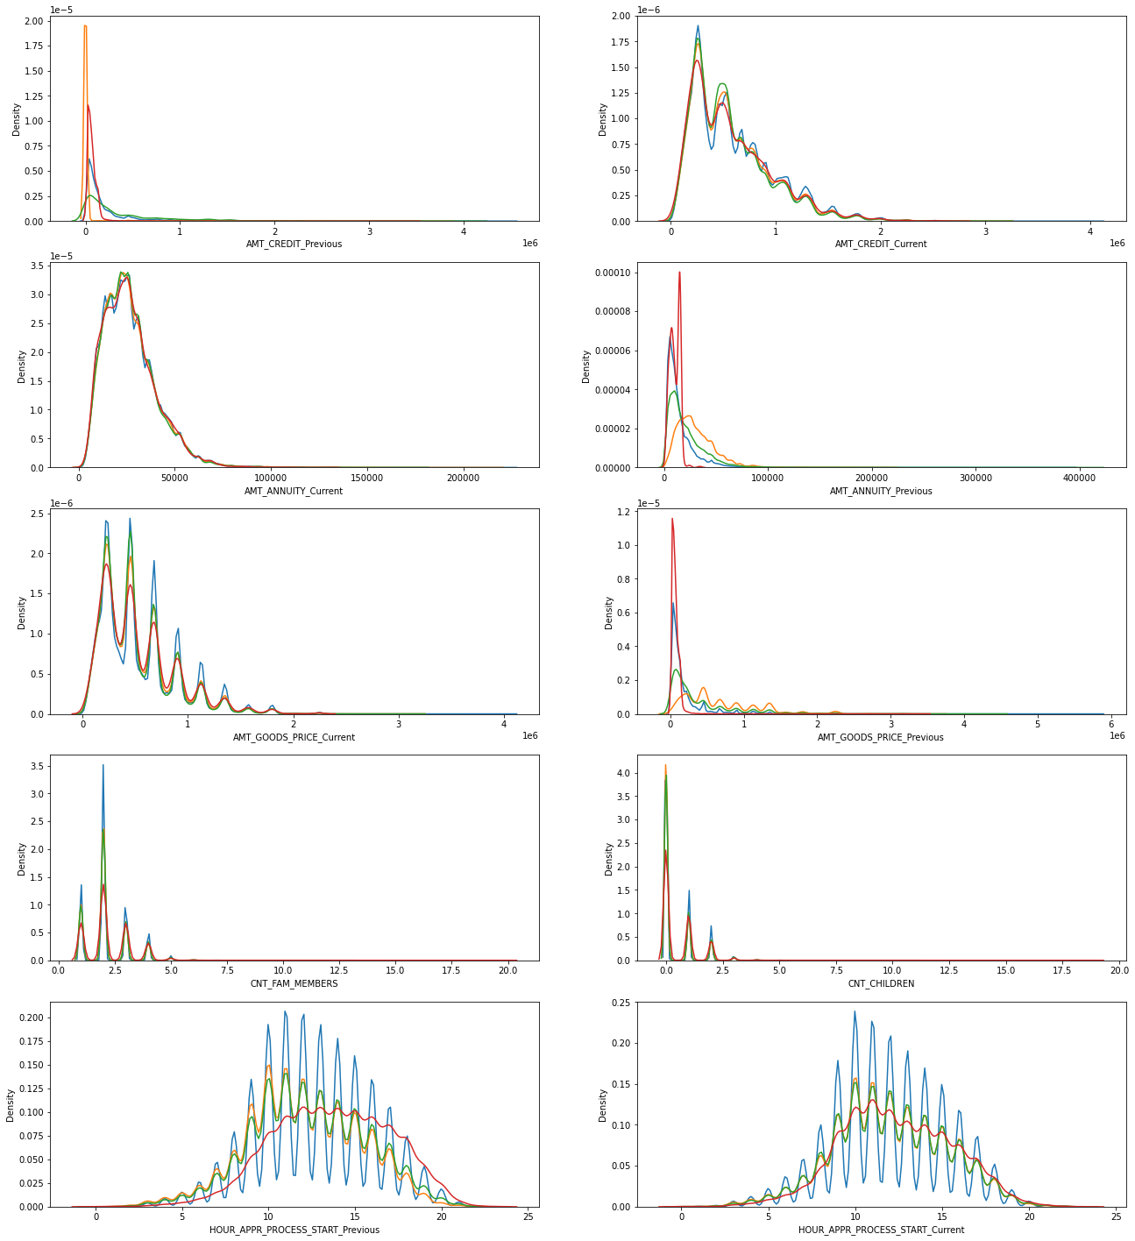
Uivariate Numerical Analysis

Slide 31
Insights:
As we can see from graphs,
High number of applications are filed in 9 AM to 2 PM for both Current and Previous data.
Nuclear family tends to take more loans.
Previously bank had high unused offers but currently,
- refused is high incase of AMT_GOODS_PRICE.
- cancelled/refused offers are similar for AMT_ANNUITY.
- high number of refused offers for AMT_CREDIT.

Slide 32
Bi-variate Analysis

Slide 33
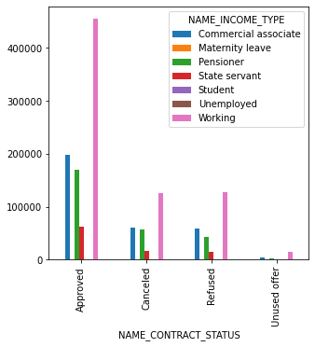
Name_Contract_Status Vs Name_Income_type
Insights:
From the graph it is observed that the applicants whose income whose income type is working are higher in approved/cancelled/refused.
Among all, income type working applicants applications are highly approved (>4L) as the comes under non-defaulter.
Followed by, applicants who are commercial associates applications are approved (nearly 2L)
L - Lakhs

Slide 34
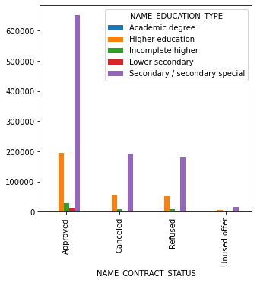
Name_Contract_Status Vs Name_Education_Type
Insights:
Most of the applicants whose applications are approved has the education type as secondary/secondary special.
More than 6L applicants who are secondary/secondary special qualified.
The next highest applications whose education type is Higher education are approved

Slide 35
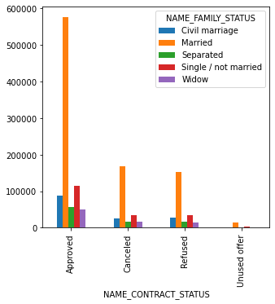
Name_Contract_Status Vs Name_Family_Status
Insights:
Most of the applicants who applied for loan previously are also married.
More than 80% of the married applicant’s applications are approved previously.
Previously, second highest applicants whose applications are approved are single/not married
Only, few of separated/widow type people are applying for loans.

Slide 36
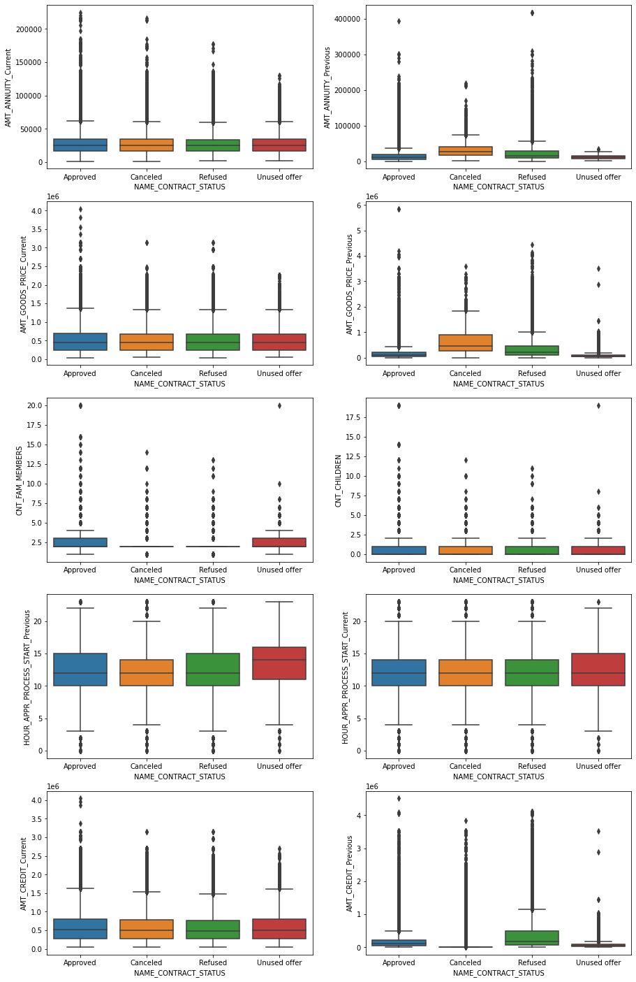
Bi-variate Continuous Plots

Slide 37
Insights:
AMT_CREDIT_Previous has highest refused cases and AMT_CREDIT_Current is similar for all 4 cases.
Time spent in unused offer is higher as compared to other categories so, bank should reduce time spent on unused offer.
Nuclear family(2-3 people in family) get highest approval.
Previously most of the applications were cancelled or refused.
But now Refused/Cancelled/Approved/Unused all four have similar situation for both AMT_GOODS_PRICE & AMT_ANNUITY

Slide 38
Conclusion
Target/focused variable for Application dataset - TARGET.
Target/focused variable for Previous dataset - NAME_CONTRACT_STATUS
Top Major variables to consider for loan prediction:
Name_education_type
Amt_income_total
Days_birth
Amt_credit
Days_employed
Amt_annuity
Name_income_type
Code_gender
Name_housing_type
The above mentioned variables are to be considered before approving application to minimize risk of loss.

